Slide 1
Optimizing Social Media Customer Service For UK National Railway
GROUP4:
Abhik Modi
Eduardo Hernandez
Gaurav Sharma
Saurabh Chakravorty

Slide 2
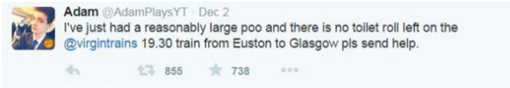
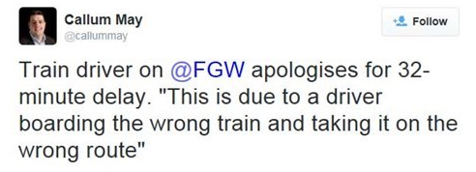
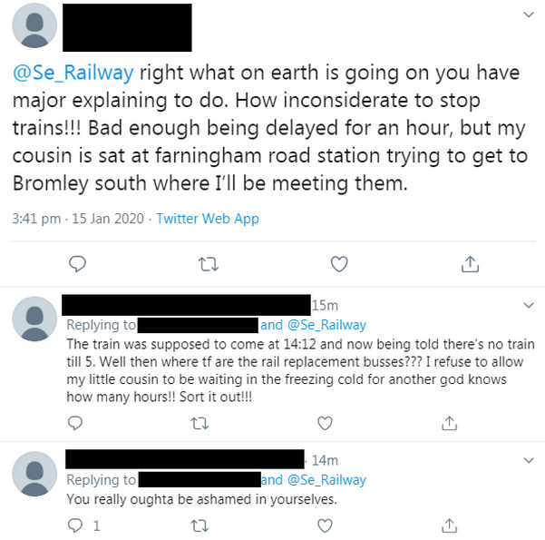
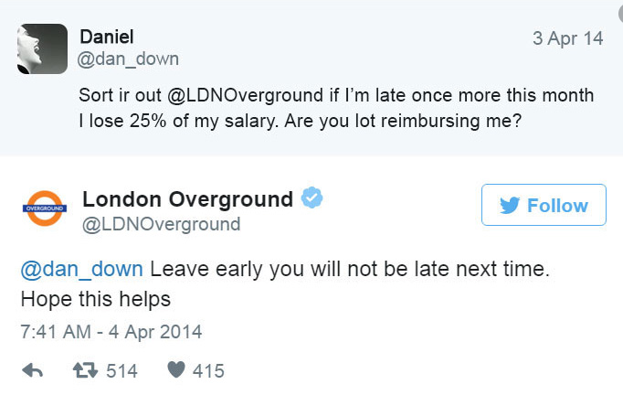
Source: Twitter

Slide 3
AGENDA
PROBLEM STATEMENT
STRATEGY MAP
TOPIC MODELLING
KEY PROCESS INDICATOR
CONCLUSION

Slide 4
PROBLEM
STATEMENT
UK Railway Performance For Last Three Years

Slide 5
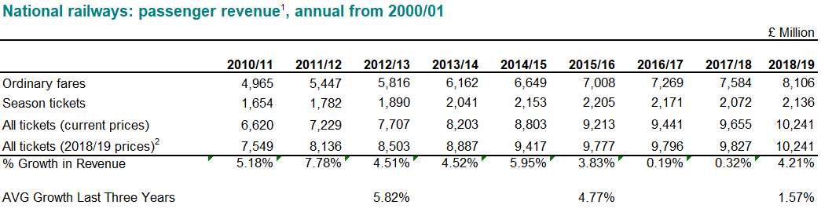
PERFORMANCE
Revenue Perspective
3.2%
Decrease in Revenue Growth
(averaged over three years)
Source: Office of Rail and Road (ORR)

Slide 6
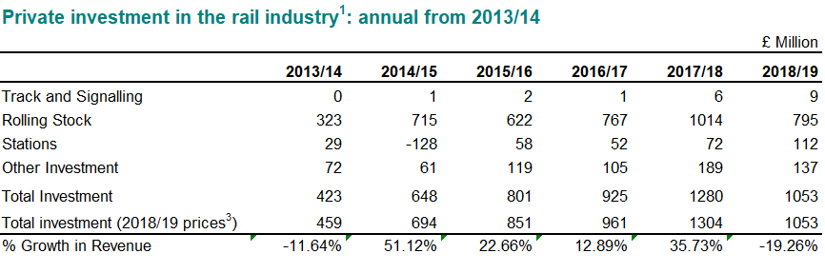
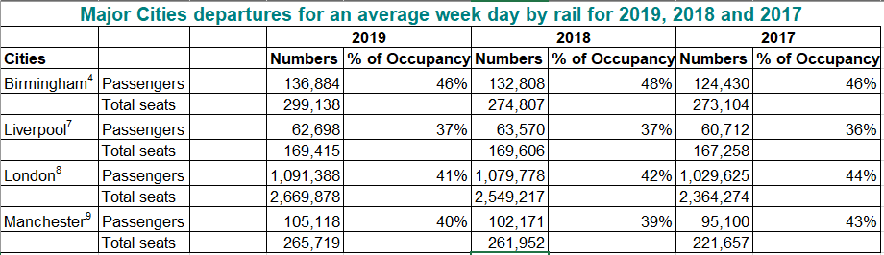
PERFORMANCE
Private Investment Perspective
-19.26%
Decrease in Private Investments
Passenger Count Perspective
Source: Office of Rail and Road (ORR)

Slide 7
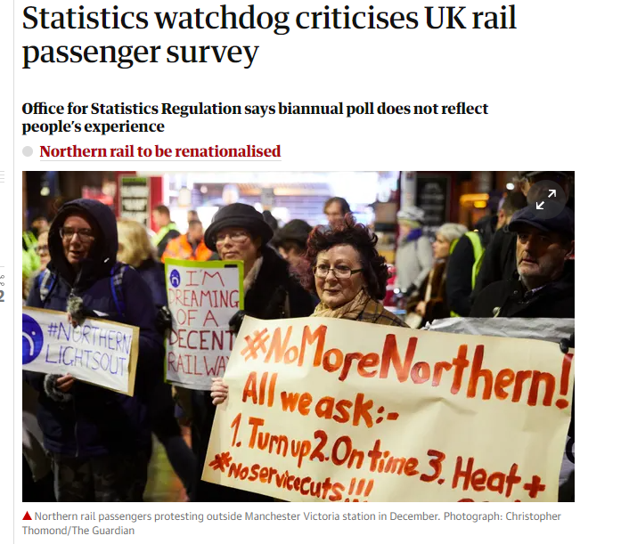
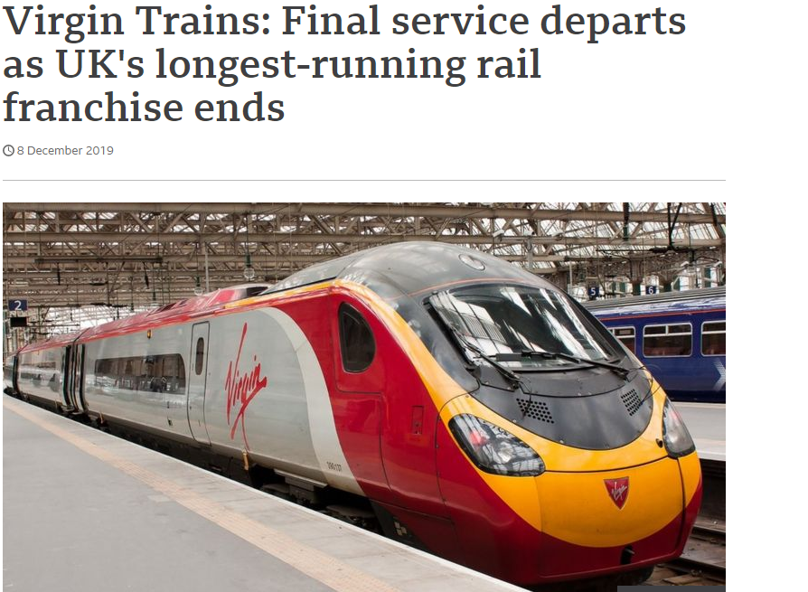
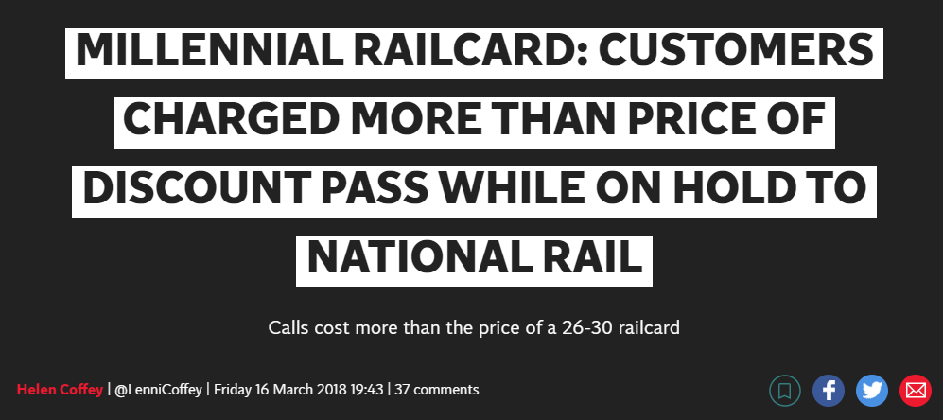
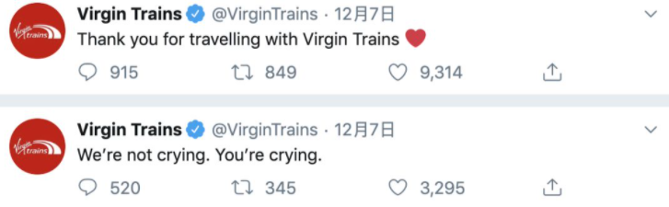
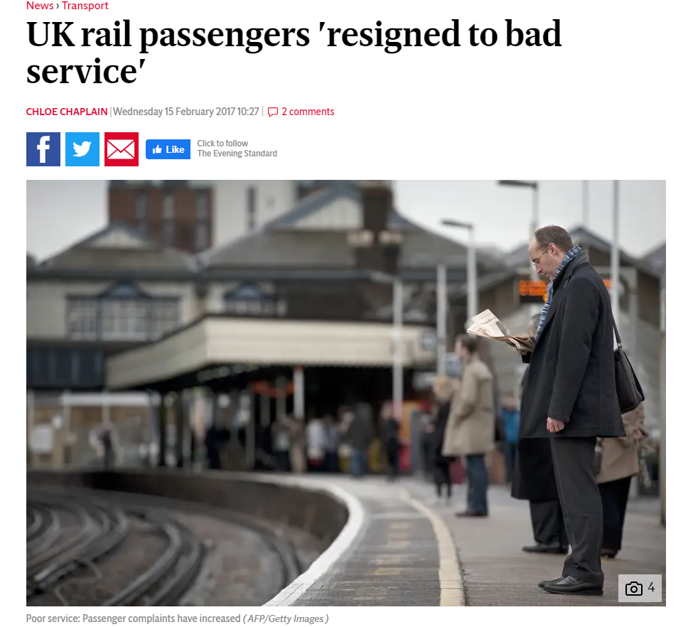
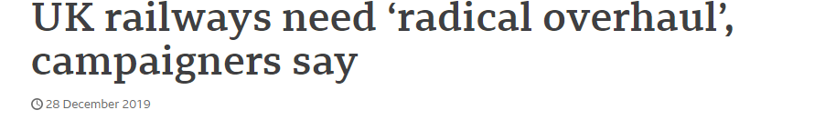
UK Digital Literacy
75%
84%
75% Women and 80% Men are digitally literate in UK
5 million active social media users in 2020
Source: UK Gov Website

Slide 8
STRATEGY MAP
Next Three Year Vision
and
Our Plan Of Action
“Customer Centric”

Slide 9
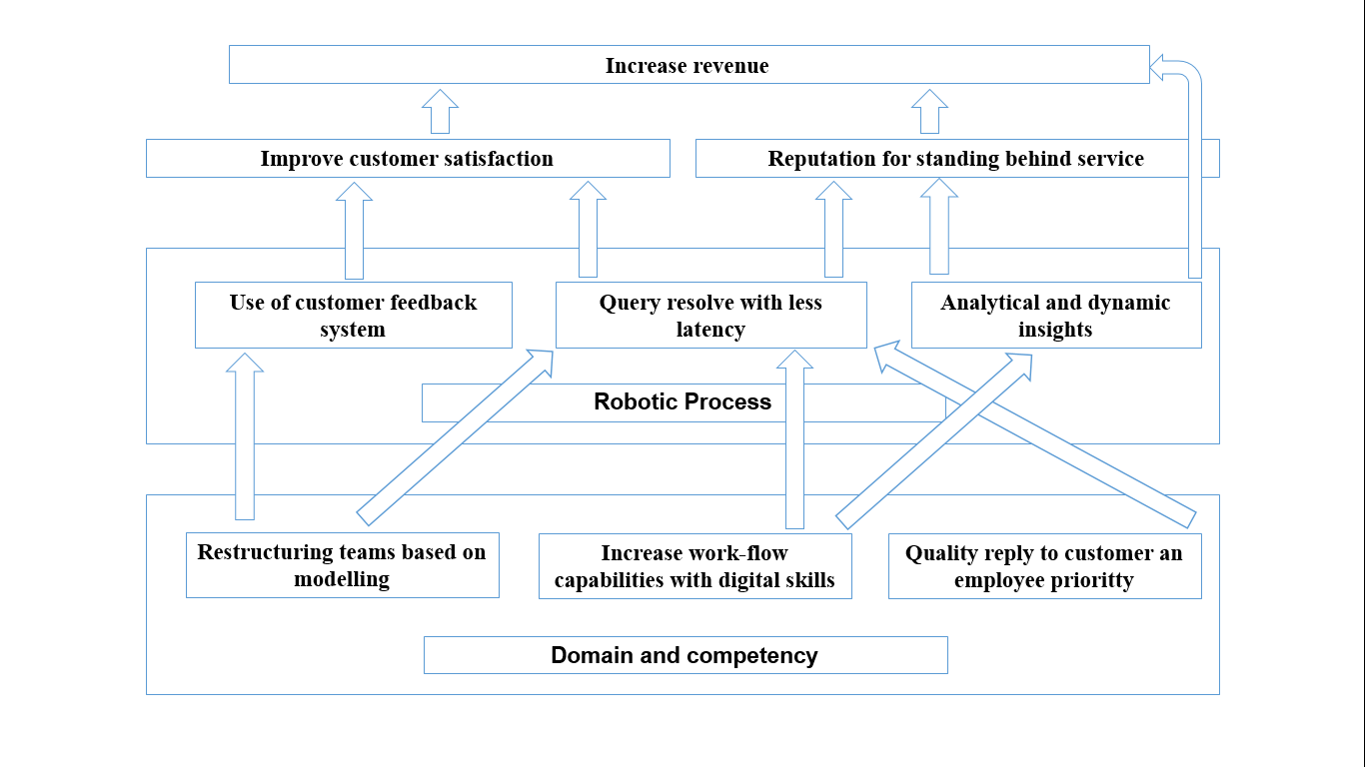
STRATEGY MAP
Financial Perspective
Customer Perspective
Process Perspective
Learning Growth Perspective

Slide 10
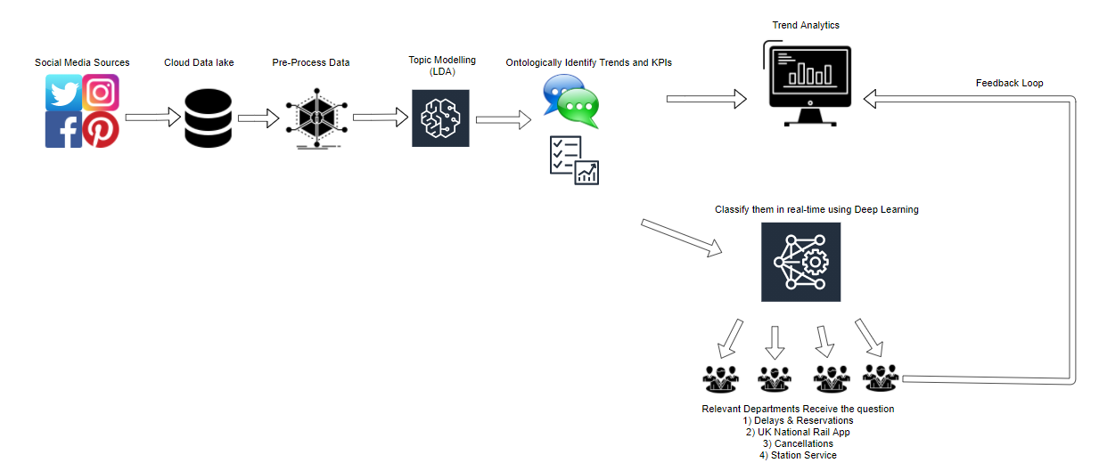
ACTION PLAN
Insight Generation for KPIs
Data from various Social Media Sources
Data Preprocessing for Topic Modelling
Clustering using
LDA
&
Classification using ML/DL
Deploy the model to assign the tweets to respective complaint team
Assigning Tweets to Different Departments

Slide 11
TOPIC MODELLING
KPIs Selection and KRA generation

Slide 12
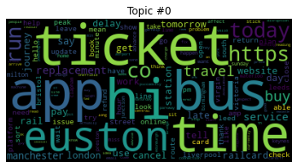
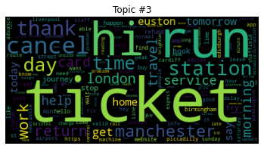
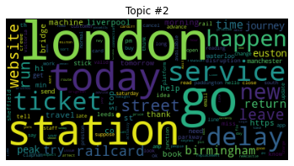
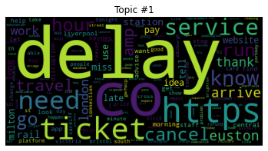
TOPIC MODELLING
LATENT DIRICHLET ANALYSIS
UK NATIONAL APP
RESERVATION
STATIONS
DELAYS & SERVICE
App Service
Confirmation/ Change & Cancellations
London- Liverpool- Platform Number
Arrivals and Departure

Slide 13
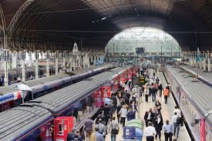
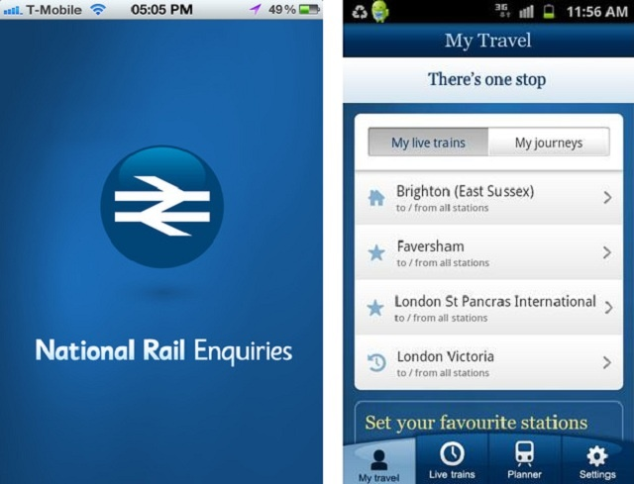
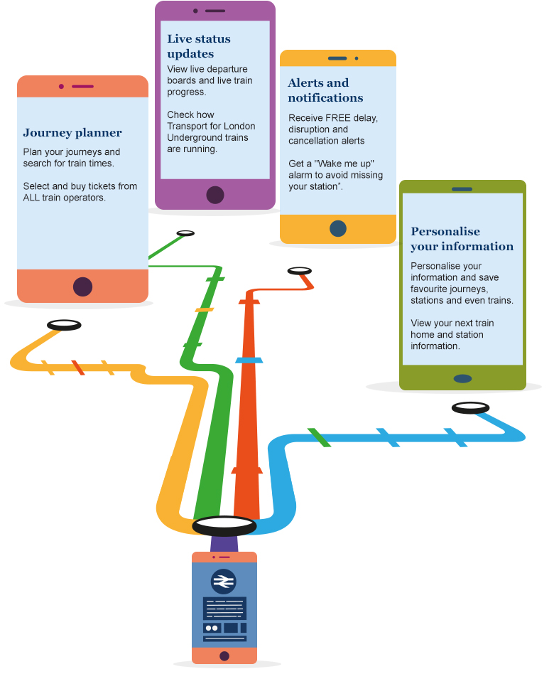
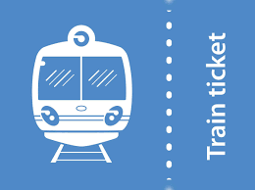
Real Time Classification
STATIONS
NATIONAL APP
Global Vector embedding
(GloVe)
Supervised Deep Learning
RESERVATIONS – CANCELATION/CHANGE
DELAYS & SERVICE

Slide 14
KEY PERFORMANCE INDICATORs

Slide 15
Please refer to the following Tableau file:
(click on the icon)

Slide 16
CONCLUSION

Slide 17
Thank You

